Slide 1
Bangla handwritten Character Recognition
1805064 – Sanju Basak
1805069 - Sumonta Nandy Amit

Slide 2
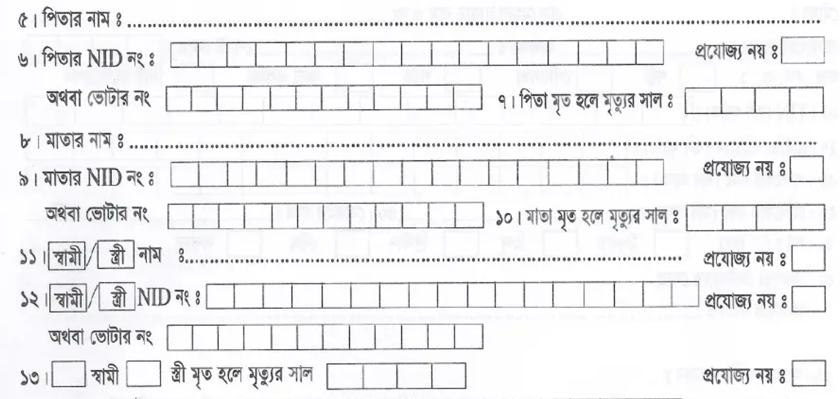
Motivation
In passport form, from box field to bangla character recognition.
In Bkash app, from NID image to data extraction.

Slide 3
Overview
Input
Box detection Model
Output
Character Recognition Model
Intermediate Results
First, we will detect the box and separate each character.
After that, the character will be given as input to our model.
The model will detect the character correctly.

Slide 4

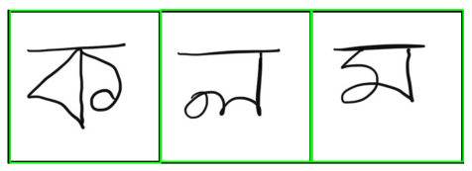
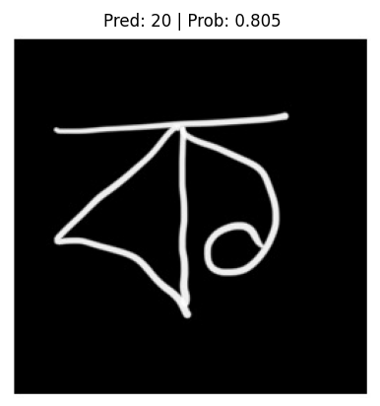
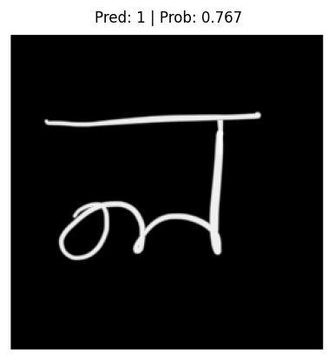
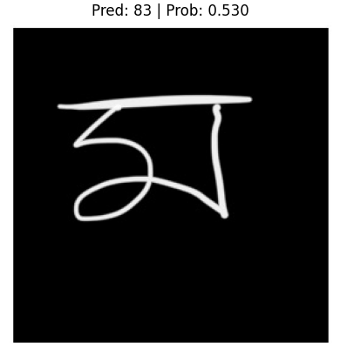
Overview (continued…)

Slide 5
Pre-trained Models
Name | Source | Pretrained on
Yolov8 | https://github.com/ultralytics/assets/releases/download/v8.1.0/yolov8l.pt | https://paperswithcode.com/dataset/coco
Efficient Net | https://download.pytorch.org/models/efficientnet_b0_rwightman-7f5810bc.pth | https://huggingface.co/datasets/imagenet-1k

Slide 6
Experiments
Properties | Box Detection Model | Character Recognition Model
Dataset trained on | WTW | BanglaLekhaIsolated
Train: Val: Test | 8: 1: 1 | 8: 1: 1
Epoch | 25 | 15
Batch Size | 8 | 32
Learning Rate | .001 | .001

Slide 7
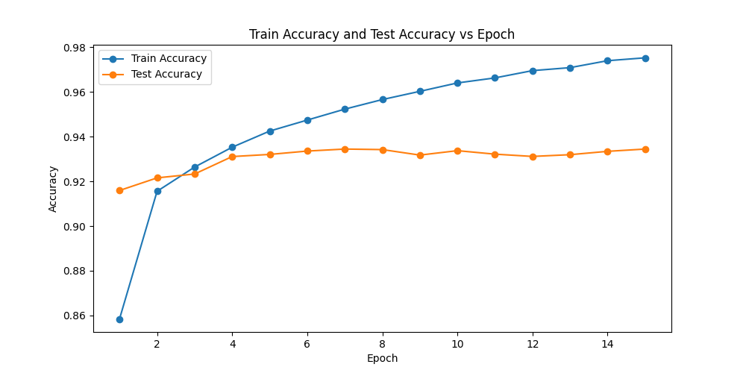
​Results

Slide 8
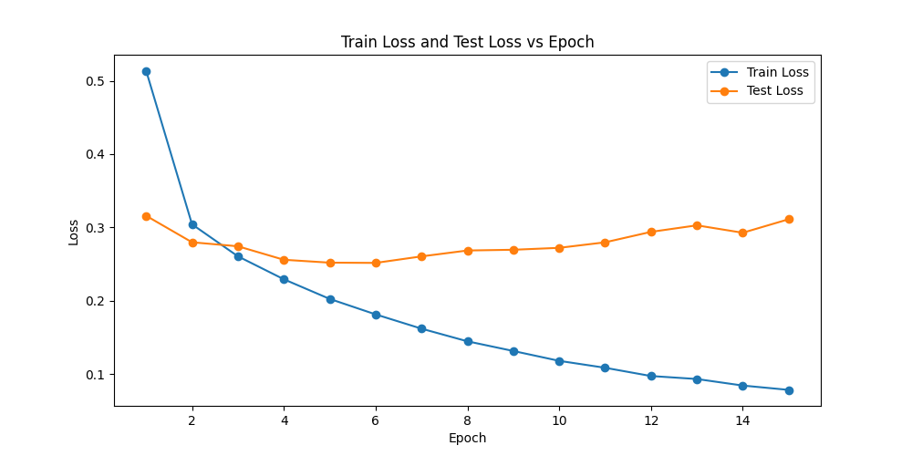
Results

Slide 9
Independent testing result
Loss: 0.29275799582672907
Accuracy: 0.9354001879692078
Precision: 0.9360302686691284
Recall: 0.9353563189506531
F1 Score: 0.9353286027908325

Slide 10
Challenges
Resource limitation
The input required for this two models were different.
So, creating the pipeline was a bit tricky.

Slide 11
Future directions​
Splitting the words without bounding box and aligning them.
Addition of more complex bangla characters in detection model.
Fine tuning the model with splitted characters.

Slide 12
THANK YOU

